Slide 1

Stock Price and Volume Time Series Analysis COMP-4449 –Data Science Capstone Suvechhya Pokhrel

Slide 2

Purpose
The goal of this project is to develop and implement a predictive model that accurately forecasts stock prices for diverse portfolio of symbols based on historical data from January 2021 to December 2022. The model aims to provide valuable insights for investment decisions and potentially enhance portfolio performance.

Slide 3

By developing predictive models for optimizing stock market entry and exit timing, this project aims to provide tools that can help everyday investors make informed and profitable investment decisions. With growing importance of personal finance and retirement planning, these models have potential to enhance financial security for people.
Significance

Slide 4
Research Question
Portfolio Management : How can predictive models be developed to optimize stock market entry and exit timing?

Slide 5
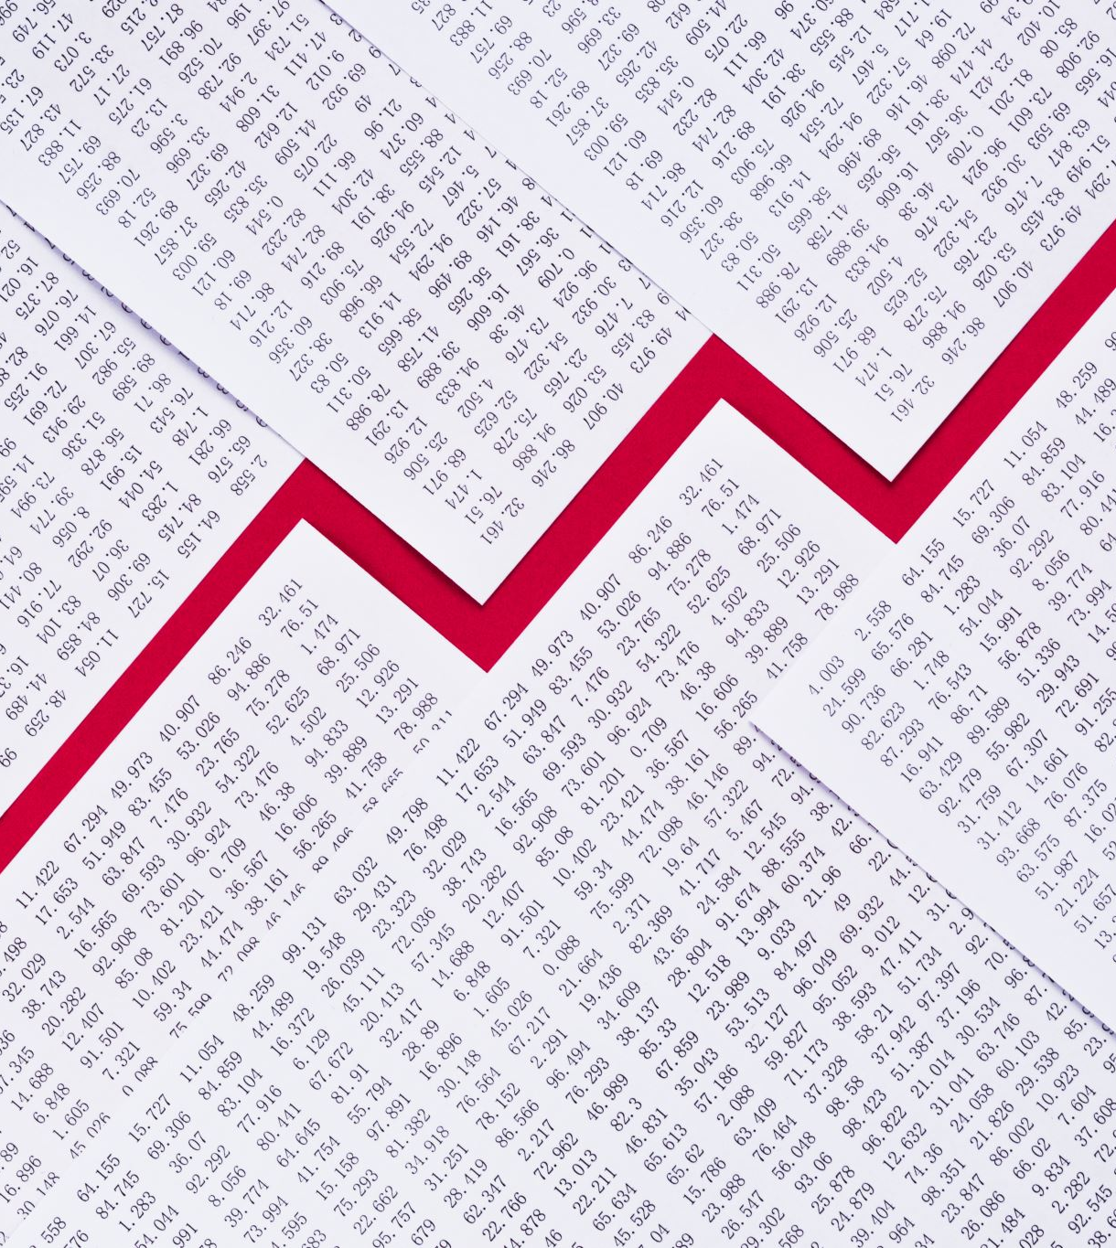
Description of the Dataset
The dataset contains 966786 instances. It has 4 columns as follows:
Symbol – Ticker symbols or abbreviations that represent specific entities, such as stocks or companies. For example, “AAPL” for Apple
Price – Weekly closing stock prices of the corresponding entity in dollars.
Vol.(1000s) – Weekly trading Volume of corresponding entity, measured in thousands
Date - Weekly timestamps from Jan 1, 2021, to Dec 30,2022.
Notes:
The dataset contains nine hundred sixty-six thousand seven hundred and eighty-six instances.

Slide 6
Exploratory Data Analysis and Visualization
Checked for Missing Values and Dropped Them. We dropped entire rows that contained null values.
Checked If all Symbols Have Records for All Dates (105 Total Weeks) and Dropped Any Symbols that Had Records for Less than 105 Weeks.
Selected a Subset of Symbols with Top 100 Average Trading Volume. Average Trading Volume for Symbols Was Evaluated for Those 105 Weeks.
Used Hierarchical Clustering to group similar stocks based on the historical price data. The distance threshold for clustering was set at a correlation between price and trading volume of 2.
Picked a Random Sample Symbol from Each Cluster reducing the number of symbols more in-depth analysis

Slide 7
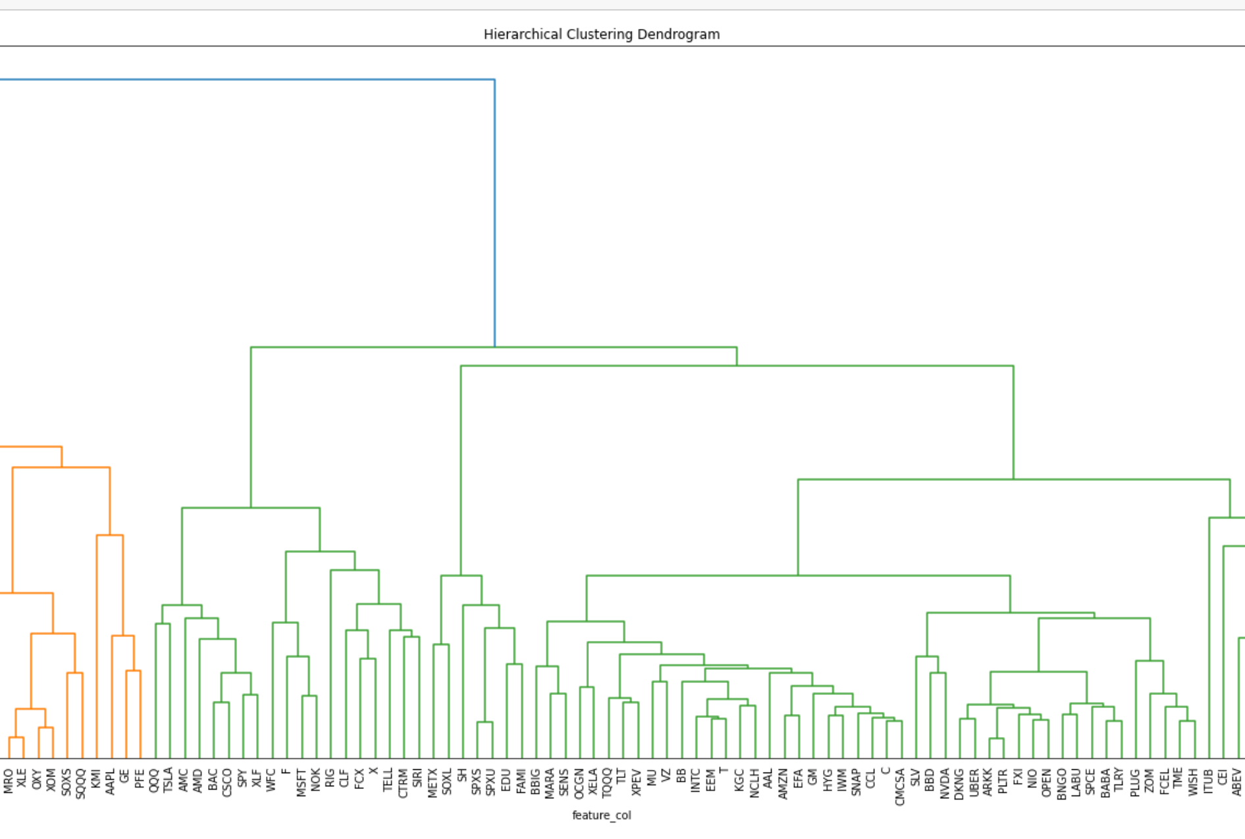
Exploratory Data Analysis and Visualization
The dendogram reveals that the first 19 stocks exhibit similar price movements when compared to larger cluster on the green side. As we move down the dendogram, the initial cluster is divided into smaller subclusters, with symbols being grouped together based on their degree of similarity and adherence to the specified distance threshold.

Slide 8
Exploratory Data Analysis and Visualization
These are the symbols along with their respective company names randomly picked from the 23 clusters:
1. NLY - Annaly Capital Management, Inc. A Real estate Investment Trust that focuses on the investment and management of mortgage-backed securities (MBS).
2. AUY - Yamana Gold Inc. is a Canadian-based precious metals mining company involved with mining and extraction of precious metals like gold and silver from properties located in North and South America.
3. PSQ – ProShares Short QQQ is an ETF designed to provide investors a way to profit from a decline in value of NASDAQ-100 index. It is an inverse ETF that consists of 100 largest non-financial companies on Nasdaq Stock Market.
4. SWN - Southwestern Energy Co. Is a US based energy company engaged in exploration of natural gas and oil resources.
5. SOXS – Direxion Daily Semiconductor Bear. Exchange-traded fund (ETF) offered by Direxion Investments for technology-related index.
6. AAPL – Apple Inc. is a well-known designs, manufactures, and markets popular devices including iPhone, iPad, Mac, Apple Watch, etc.
7. KMI - Kinder Morgan Inc. is one of the largest energy infrastructure companies in North America. It focuses on transportation, storage, and distribution of various energy products including natural gas, refined petroleum products, crude oil, CO2, etc.
8. TSLA – Tesla Inc. is another well-known American electric vehicle(EV) and clean energy company.
9. SPY - SPY Holdings is another ETF that is designed to track performance of S&P 500 Index, which comprises 500 large-cap US companies from various sectors. It is a popular choice for investors seeking broad exposure to US equities without the need to pick individual stocks.
10. NOK – Nokia Corp. Is well-known multinational telecommunications, information technology, and consumer electronics corporation.
11. FCX- Freeport-McMoRan Inc. is a mining company that extract and process copper, gold, and molybdenum.
12. CTRM – Castor Maritime Inc. Is a shipping company that operates in dry bulk shipping sector and involves in transportation of commodities like coal, iron ore, grains, minerals, and other bulk goods.
13. RIG- Transocean LTD – provides offshore drilling services to energy companies involved in oil and natural gas exploration.
14. METX- BTC Digital Ltd. – Is a blockchain technology company with a long-term strategy to create a value across the metaverse, blockchain and cryptocurrency mining industry.
15. SPXS- Direxion Daily S&P 500 Bear. ETF Fund for S&P 500 stocks managed by Direxion. Investing in “Bear” ETF is a way to profit from a decline in the S&P 500.
16. SH- ProShares Short S&P 500 is another ETF. It is managed by ProShares. SH is essentially shorts (bets against) S&P 500 Index same as above.
17. TQQQ- TQQQ Holdings is an ETF managed by ProShares designed to provide investors with three times the daily return of the NASDAQ-100 index, which comprises 100 largest non-financial companies in NASDAQ market.
18. BBD- Banco Bradesco SA – is one of the largest and most prominent financial institutions in Brazil and has a significant impact on the country’s economy.
19. FXI- iShares China Large-Cap ETF(FXI) – is an ETF that is designed to track performance of large-cap Chinese stocks. It aims to replicate performance of 50 largest and most liquid companies in Hong Kong Stock Exchange.
20. ABEV- Ambev SA - Is a multinational beverage company based in Brazil.
21. VALE- Vale SA- Is a multinational mining company based in Brazil. It is one of the world’s largest producers of iron ore and nickel.
22. CEI- Camber Energy Inc- Publicly traded energy company engaged in exploration, development, and production of oil and natural gas.
23. ITUB- Itau Unibanco Holding SA- Is a financial institution and one of the largest banks in Brazil and Latin America.
Observation:
Most of the top 100 average trading volumes are Exchange Trading Funds.

Slide 9
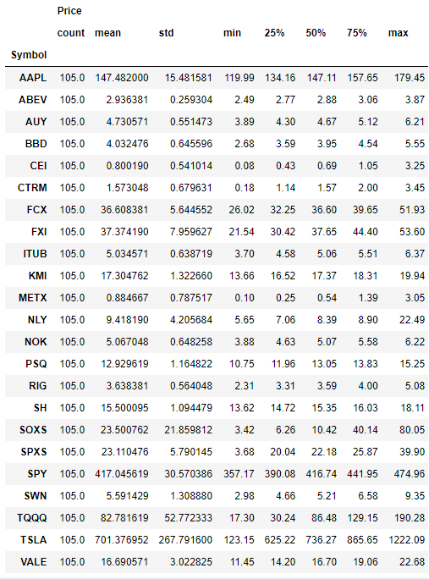
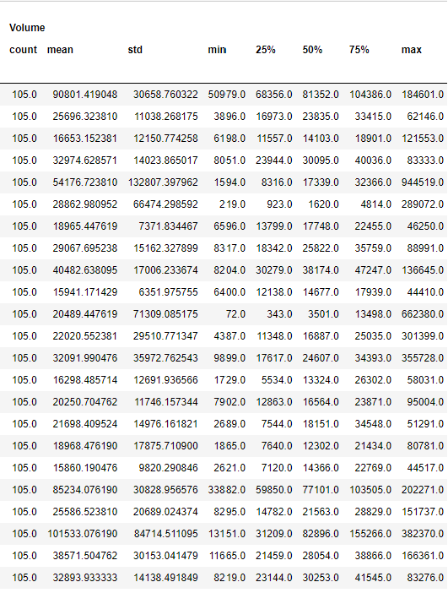
Exploratory Data Analysis and Visualization:
From above, we can observe that TSLA, SPY and AAPL have the top three highest average stock price. TSLA has the highest price of $701 whereas CEI has the lowest price of $0.81.
Looking at the trading volume column, we see that TQQQ has the highest average trading volume followed by AAPL.
Price and volume counts are both 105 indicating there are no missing values and rows.

Slide 10
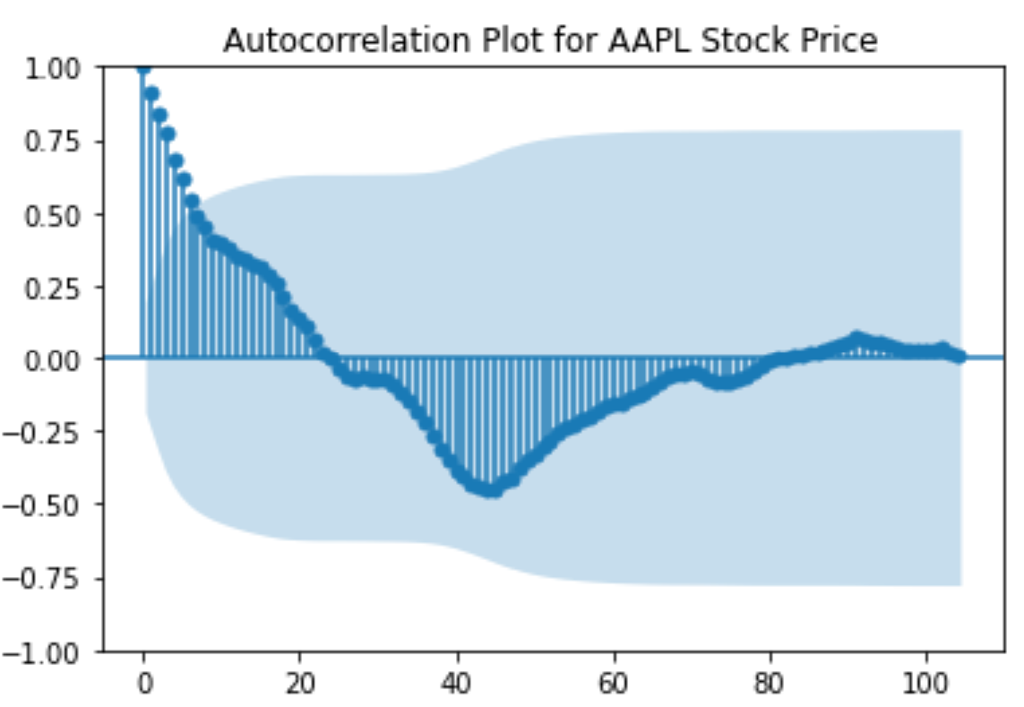
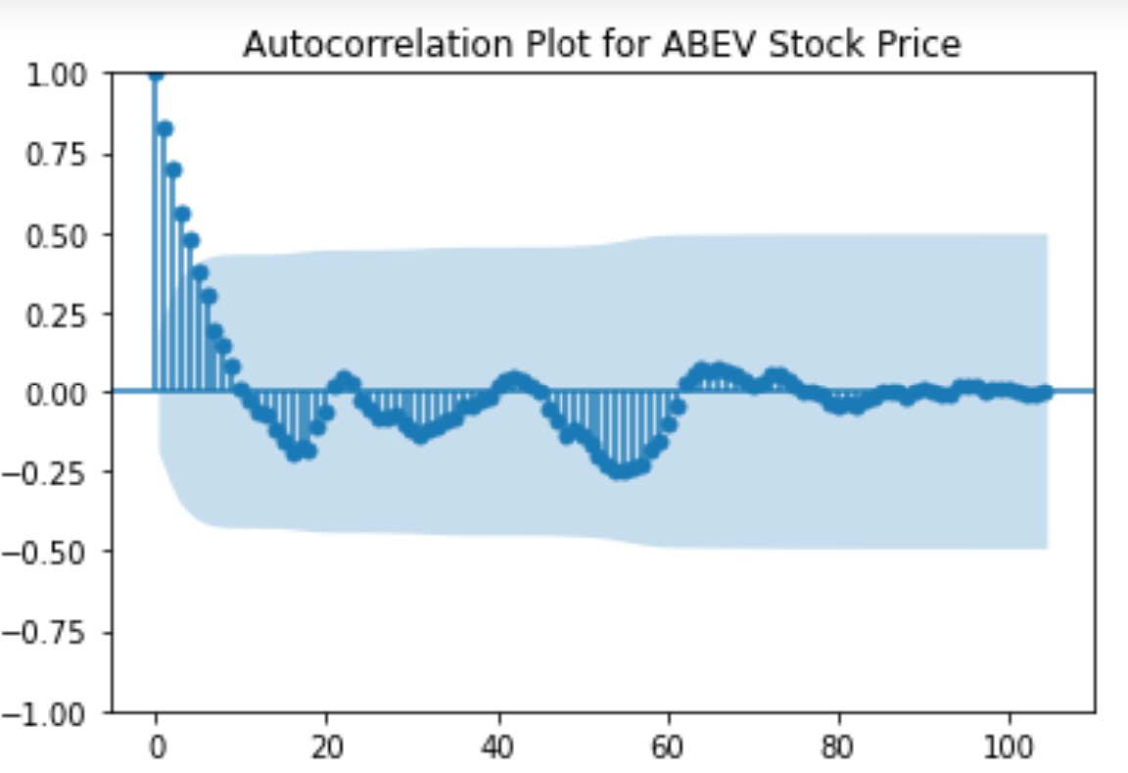
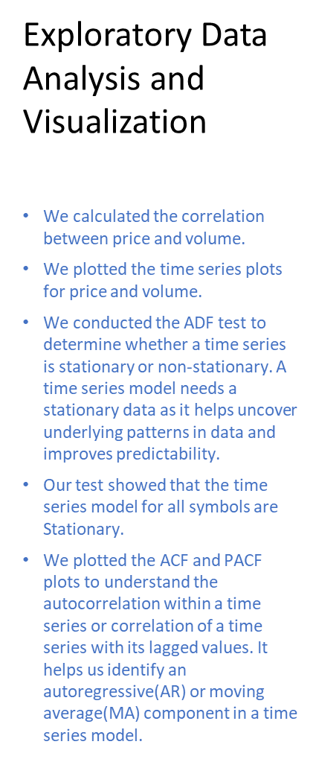
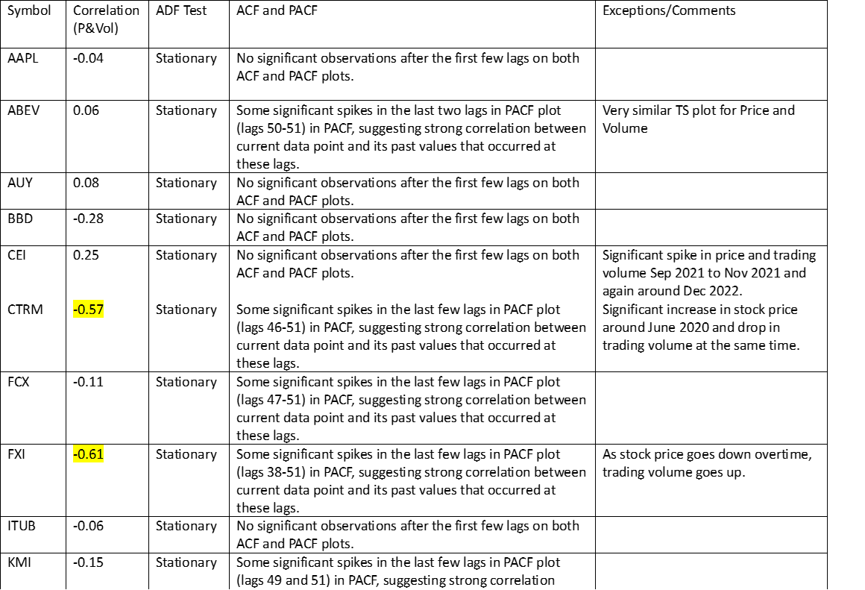
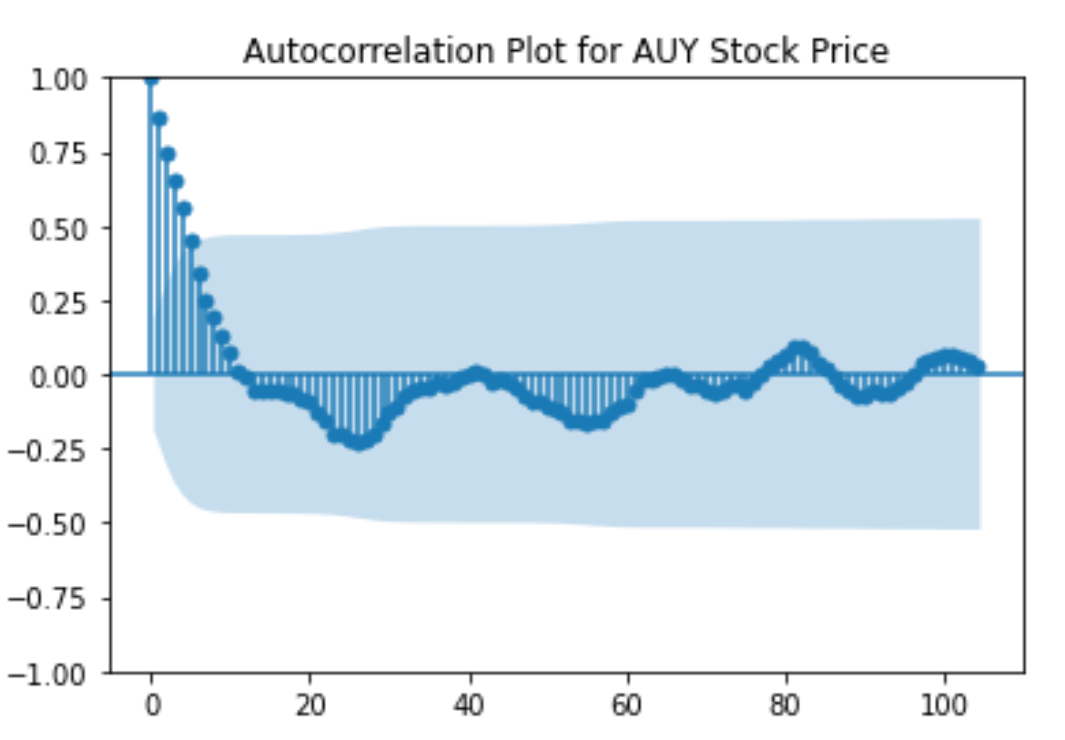
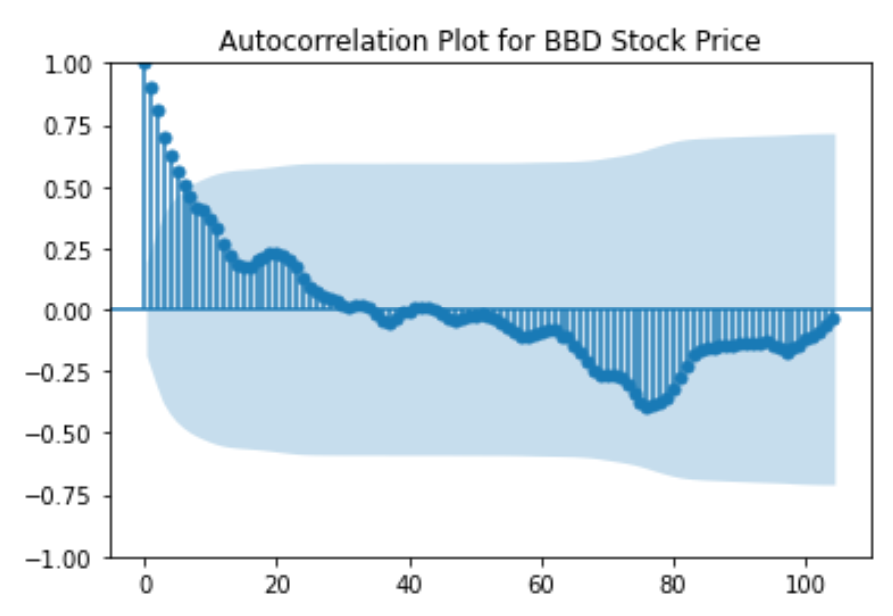
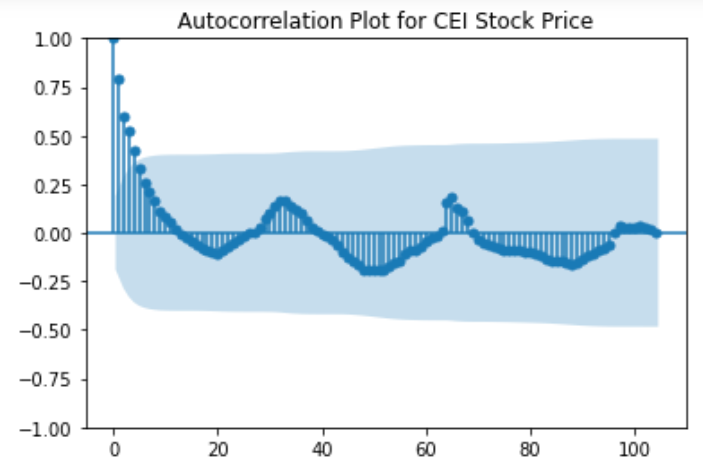
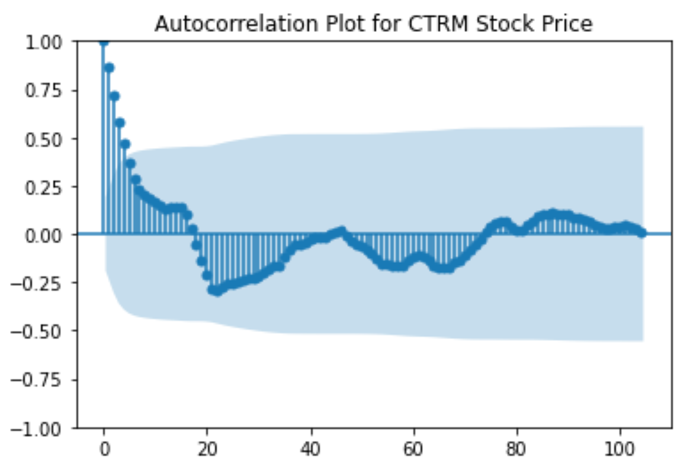
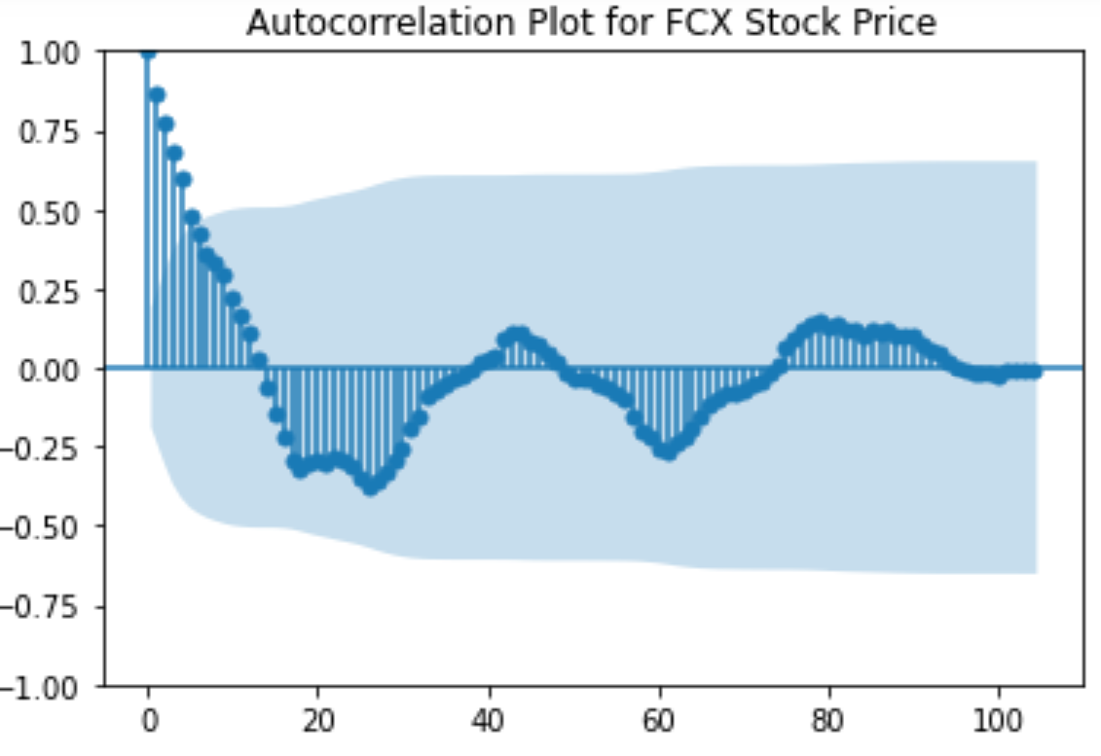
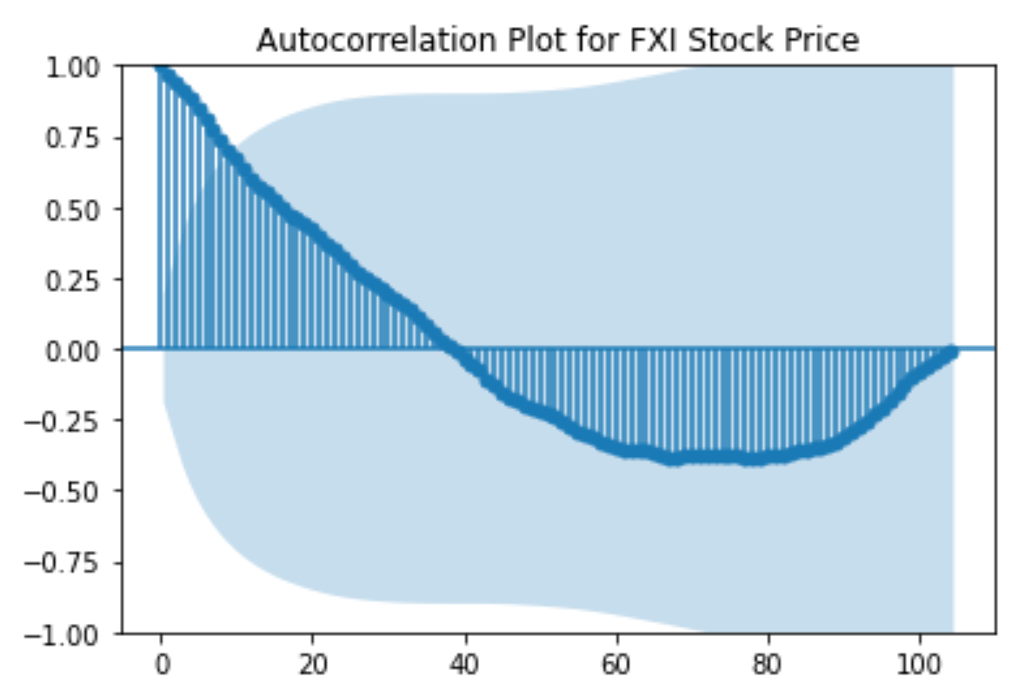
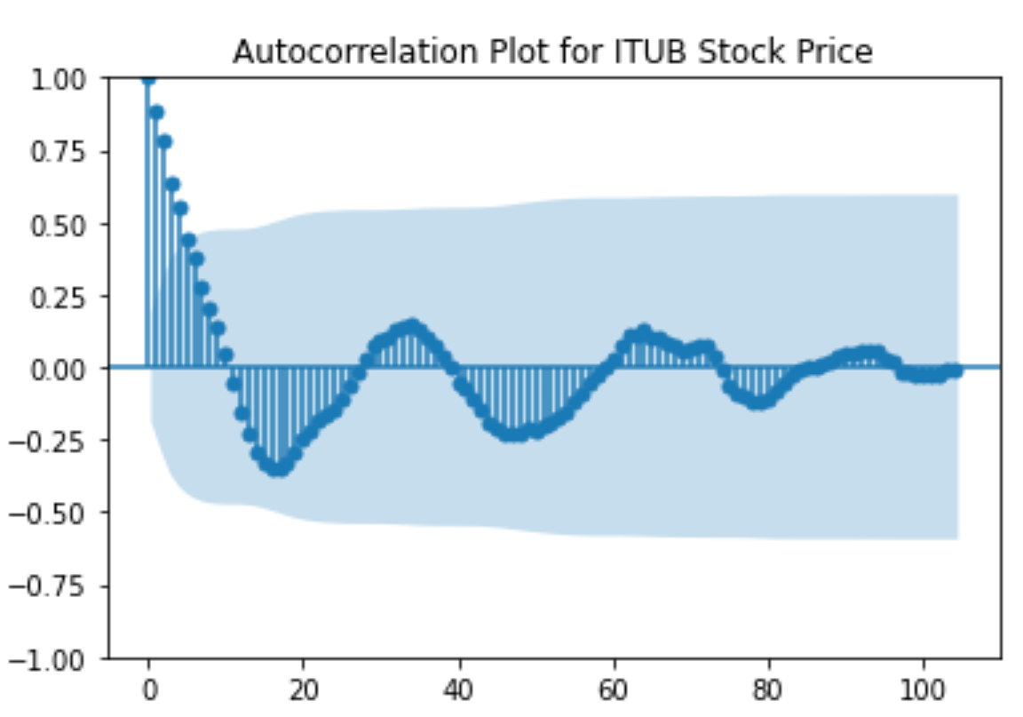
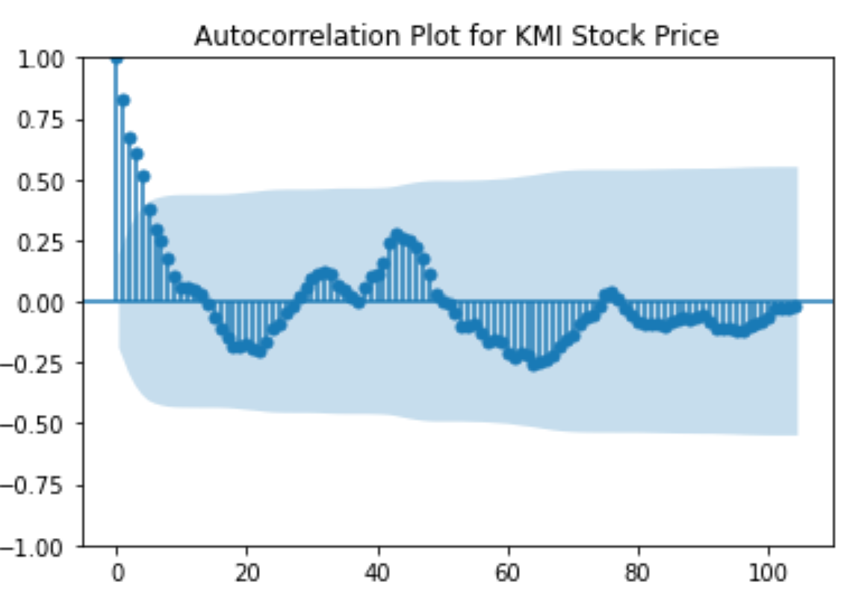

Slide 11
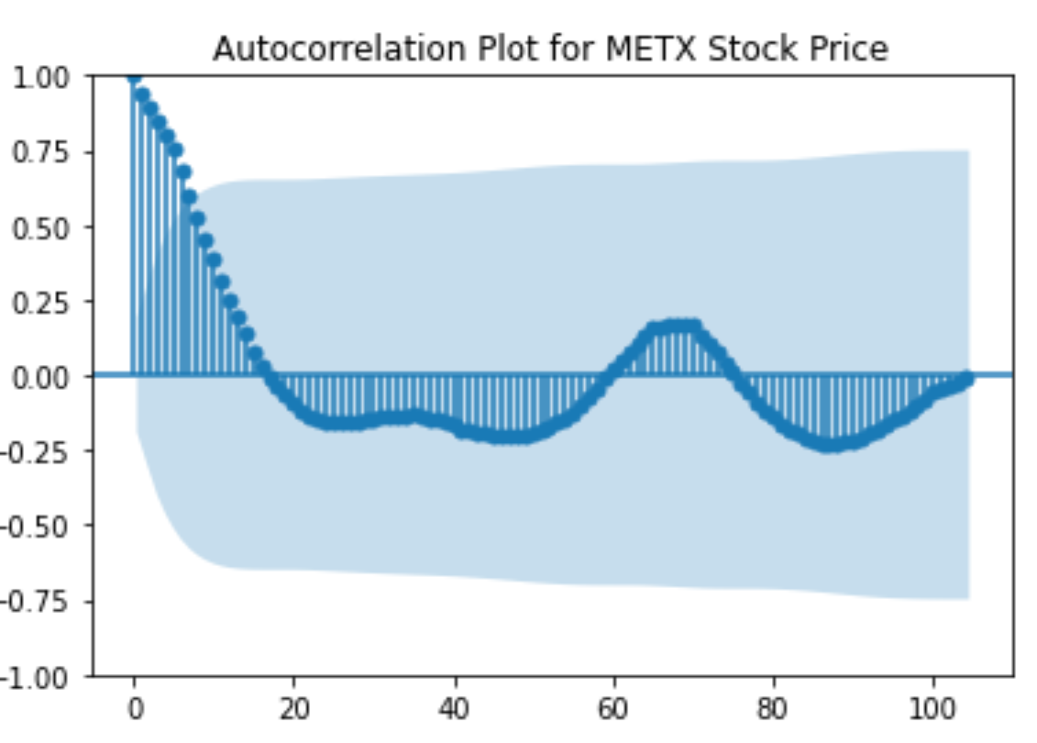
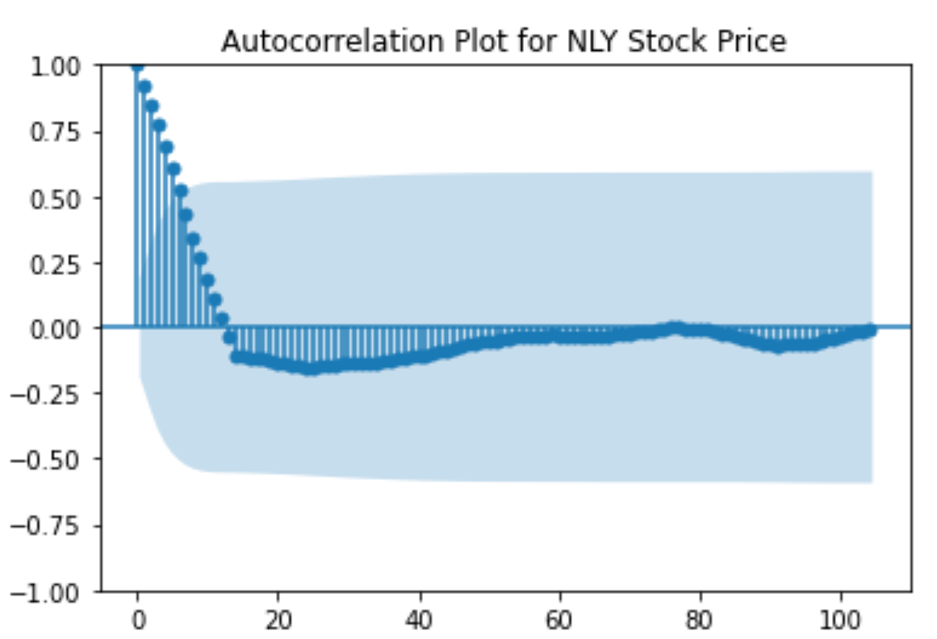
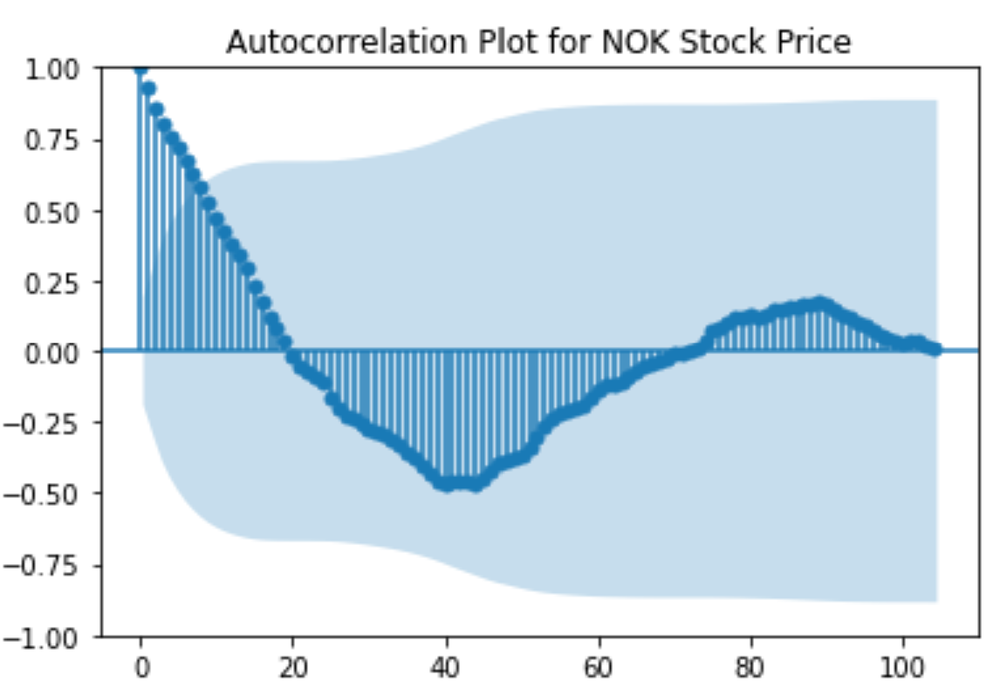
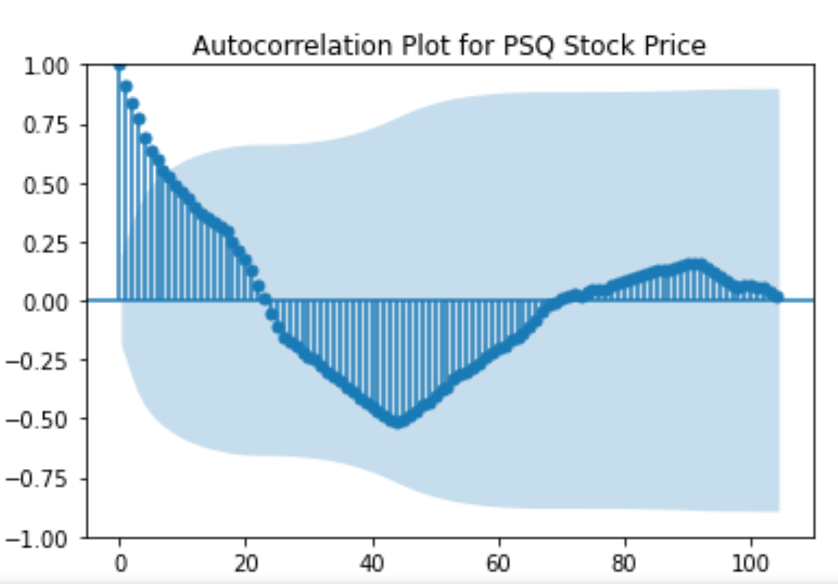
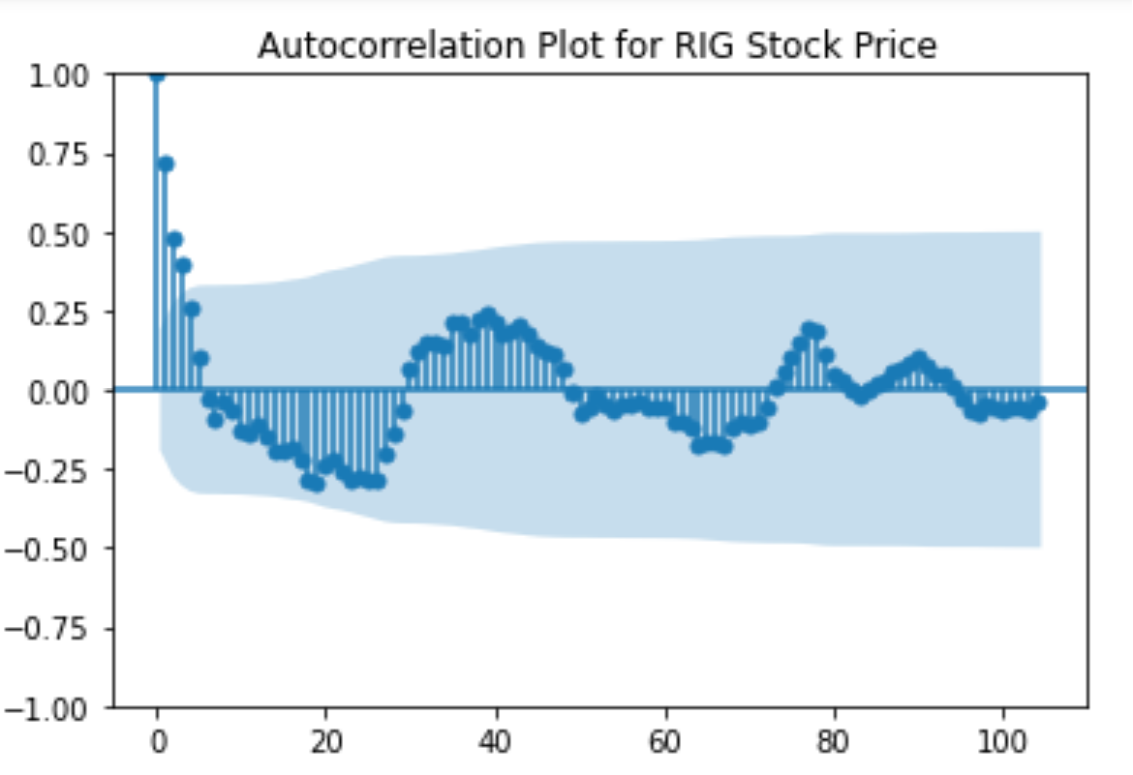
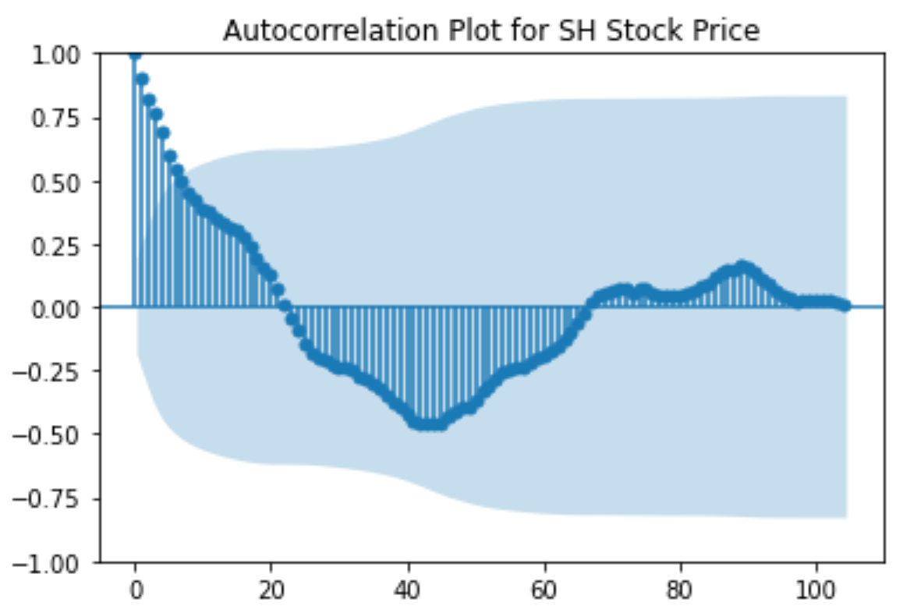
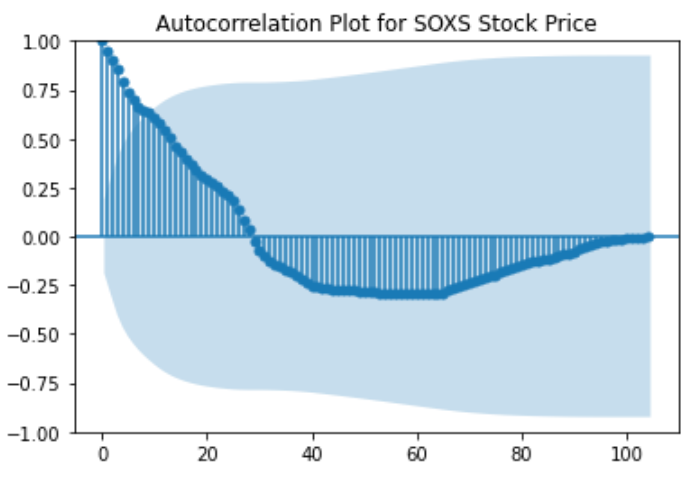
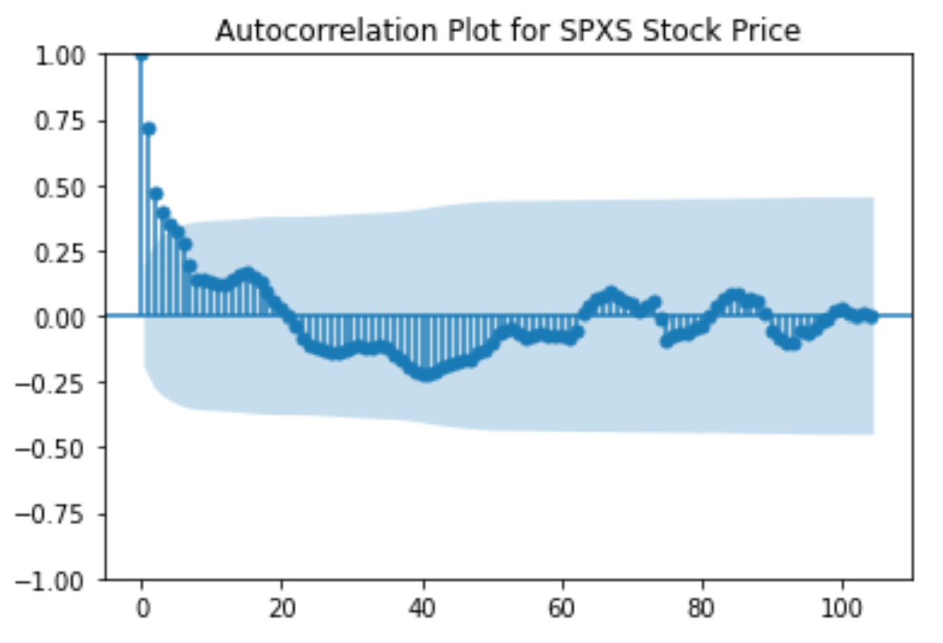
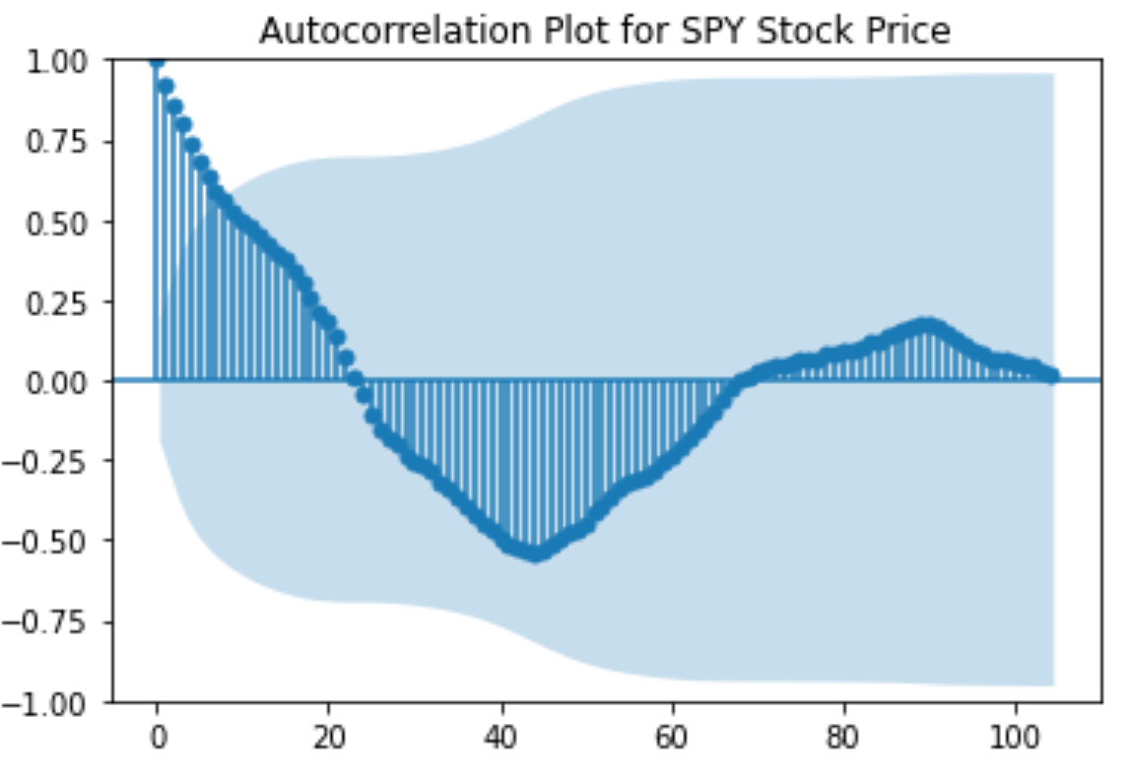
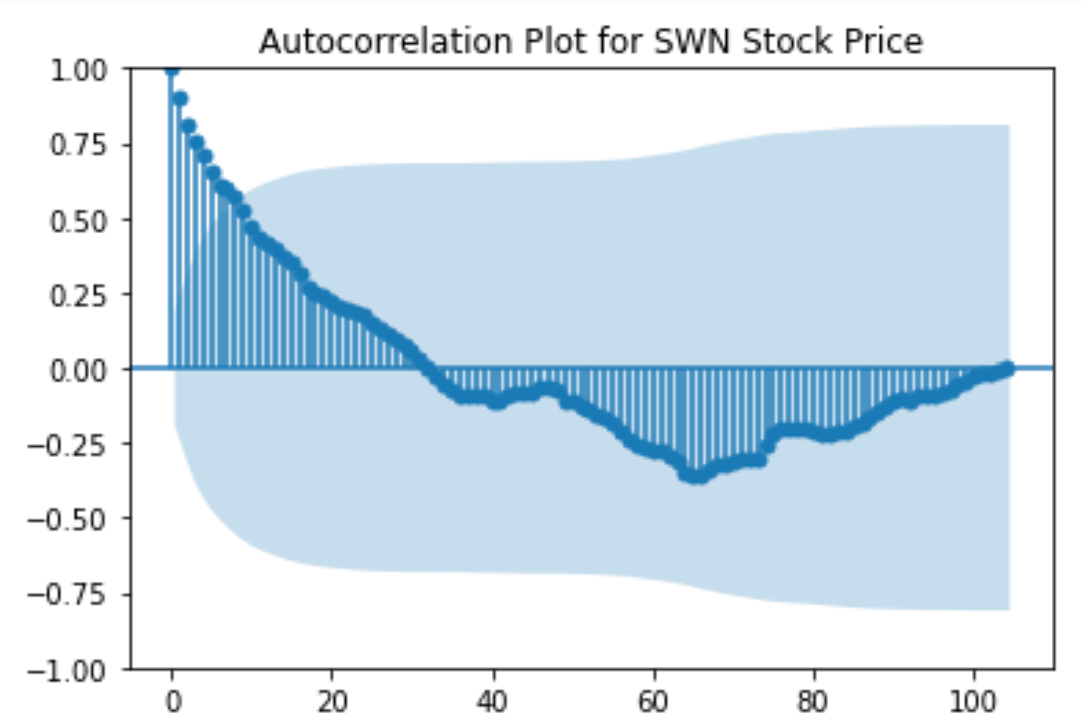
Exploratory Data Analysis and Visualization(Checking the correlation, ADF, ACF and PACF scores and plots):

Slide 12
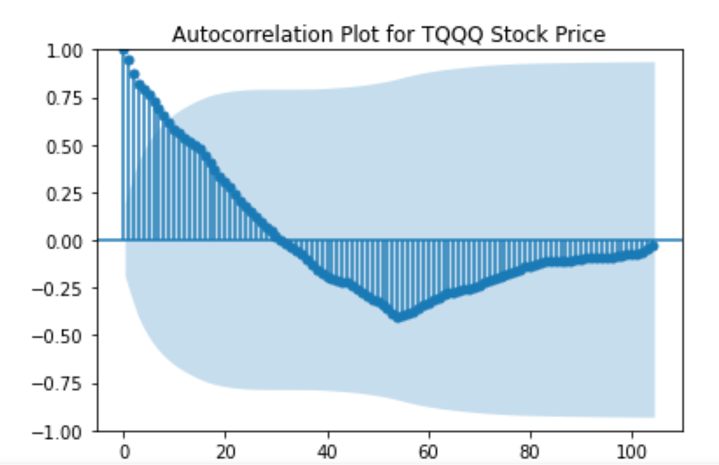
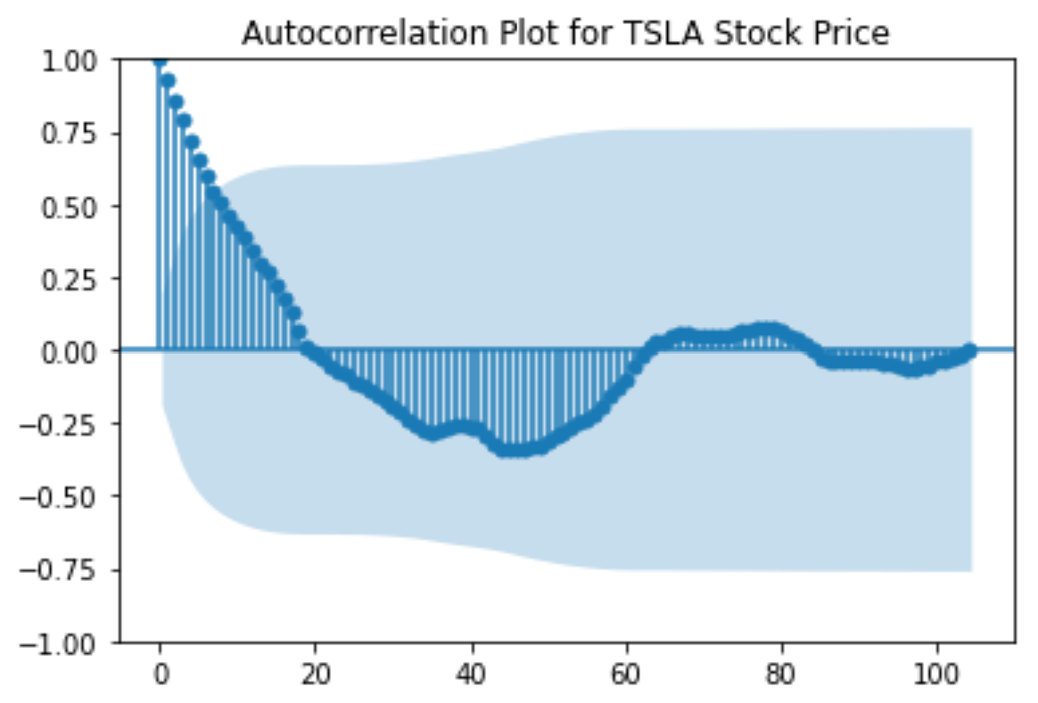
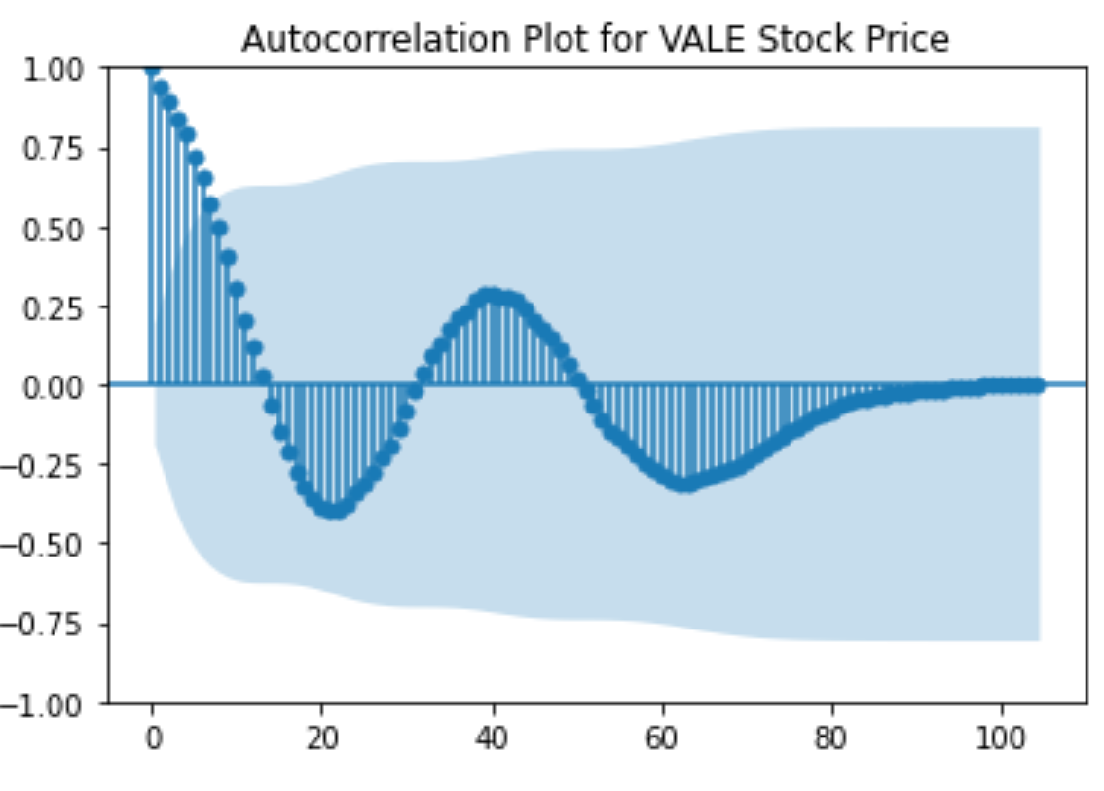
Exploratory Data Analysis and Visualization(Checking the correlation, ADF, ACF and PACF scores and plots):
Common among all symbols:
ACF: The first 7 lags for all symbols have spikes above the blue shaded region. These spikes suggest a strong positive correlation between the current data and the values from the previous one to seven weeks. It also suggests a presence of weekly seasonality.
PACF: A spike above blue shaded area at lag1 indicates strong significant partial autocorrelation or there is a direct relationship between current value and the value one step back. This indicates a presence of AR(1) term in our time series model.

Slide 13
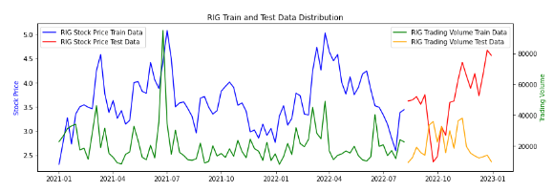
Data Splitting:
When dealing with time series data, it is recommended to use the more recent data for testing and the older data for training.
We split the data into training data, consisting of the initial 80% of the records, and testing data, which comprises the most recent 20% of the data.
Example figure shown below

Slide 14
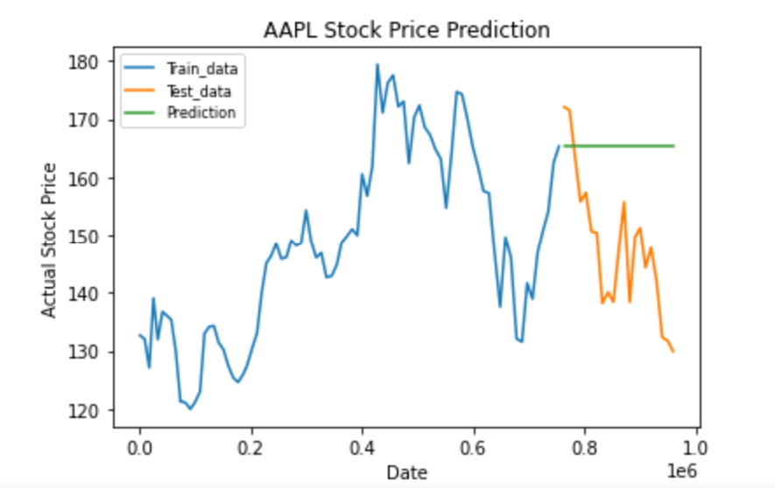
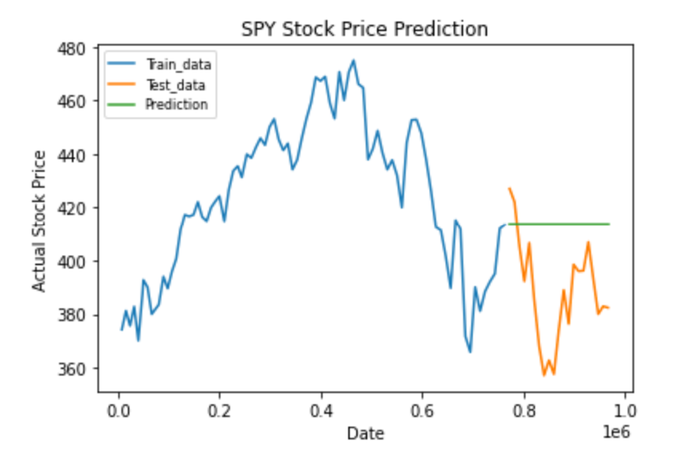
Model Building and Evaluation(ARIMA):
We used AutoARIMA model to fit our data and predict the stock prices
The model's prediction does not pick any fluctuations in price. The prediction graph is flat or smooth compared to the train and test data. The model's predictions are significantly different from the actual prices.
Example figures shown below.

Slide 15
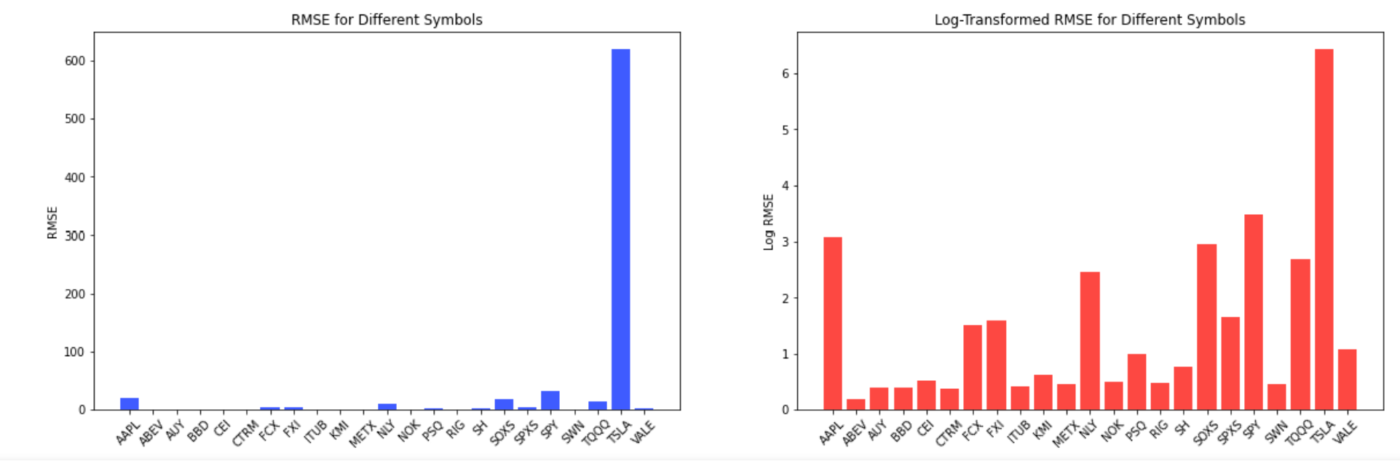
Model Building and Evaluation:
RMSE is the difference between predicted values and actual observed values. We notice that the RMSE for TSLA is quite high i.e. average stock price is $701 and RMSE is $618, suggesting the model's predictions are not accurate in relative terms. The RMSE scores for other symbols are relatively high too, suggesting a need for a more improved model that provides more accurate predictions.

Slide 16
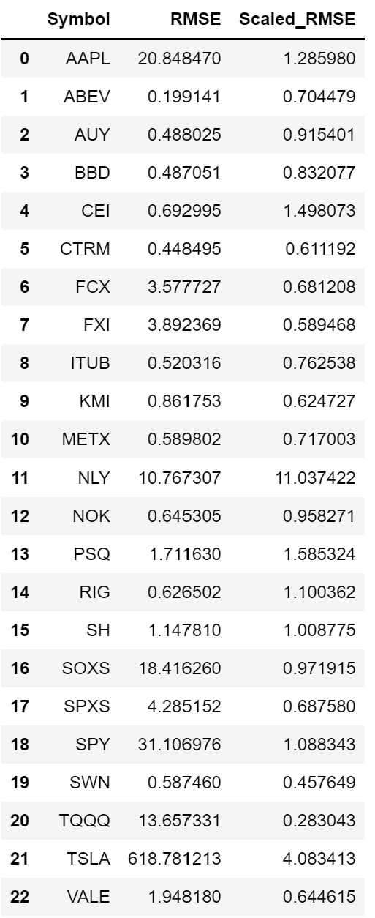
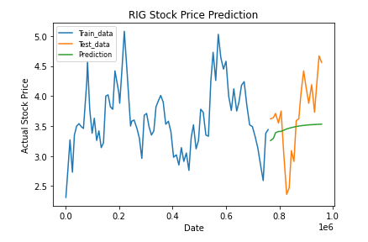
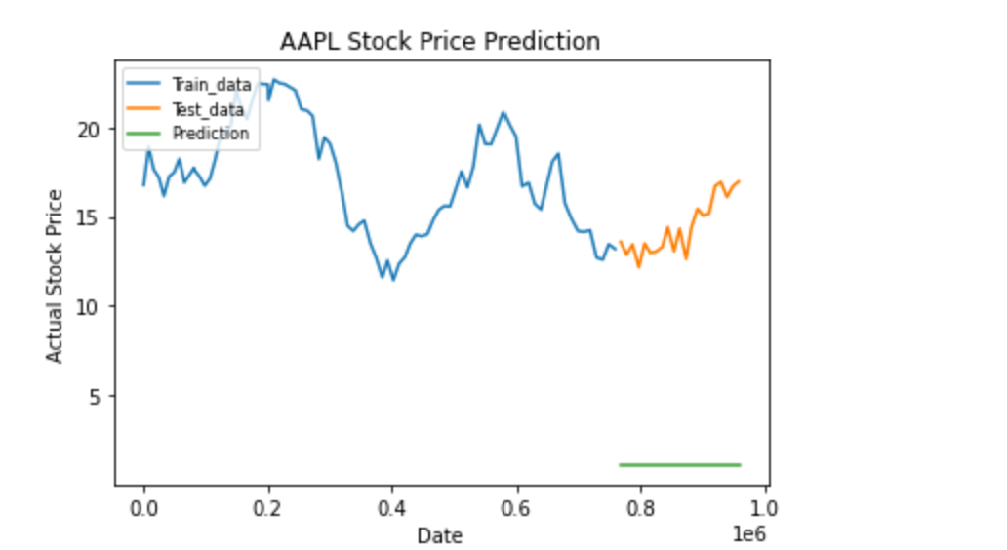
Data Scaling:
Since our price and volume columns have very different scales and prices for some companies are much higher than the others, we are using standard scaling for this data to see if it improves our model performance.
Conclusion: Scaling the data made a significant improvement in the RMSE scores but the prediction graph still did not pick any fluctuations in prices.

Slide 17
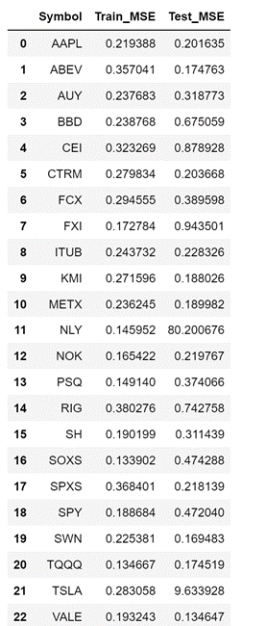
Model Building and Evaluation(LSTM):
Next, we used LSTM forecasting model to fit our data and predict the stock prices.
A small train MSE indicates that our model is fitting the training data very well and capturing the training data's patterns and variability.
A small test MSE indicates that our model generalizes well to unseen data making our predictions reliable.
So, low MSE on both train and test MSE we see above indicates that our model's predictions are very close to the actual values.

Slide 18
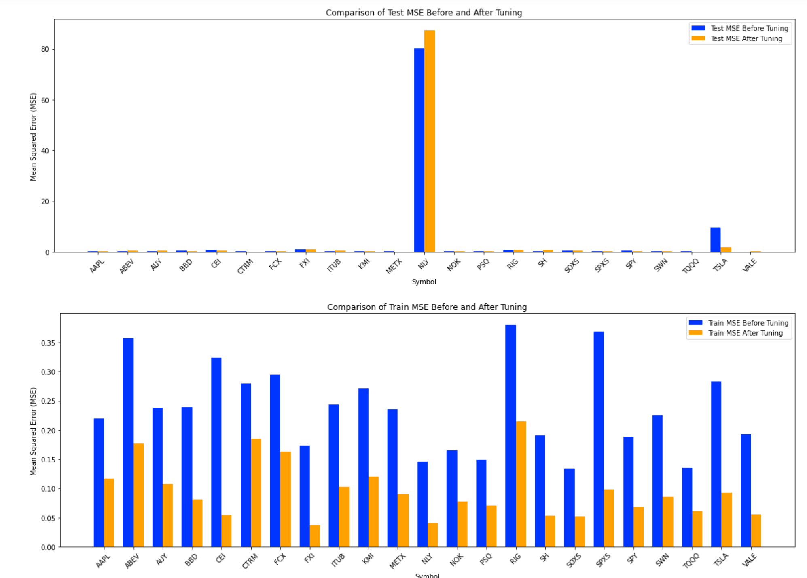
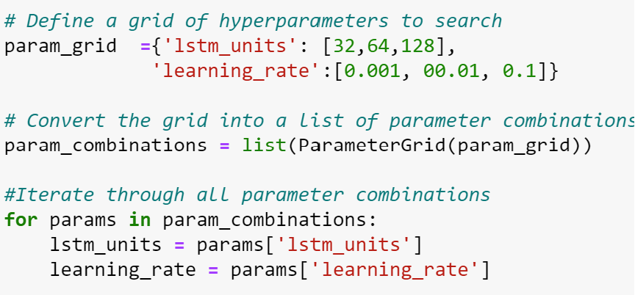
HyperParameter Tuning (LSTM):
We did a hyperparameter tuning on our LSTM model to improve model’s performance.
We can see that the train MSE improved significantly after hyperparameter tuning for all symbols.
The test MSE for NLY is very high and did not improve after hyperparameter tuning but for other symbols it has improved significantly after tuning.

Slide 19
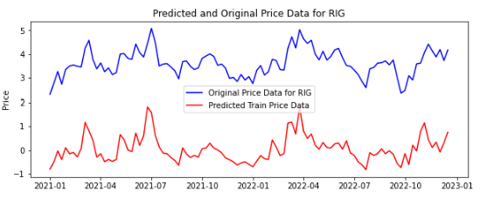
Prediction and Analysis:
We predicted the future prices of the stock using the best model from hyperparameter tuning.
We can observe that the LSTM model picks the fluctuations in price and volume data much better than the ARIMA model.

Slide 20
Conclusion, Lessons Learned, and Further Plans
LSTM was a better model for predicting stock prices and trading volume.
For future analysis, we plan to experiment with various thresholds for hierarchical clustering to see how they affect the resulting clusters and whether they provide any meaningful insights.
We intend to define specific trading signals, such as buying a stock when the 16-week moving average is greater than the 50-week moving average and selling it when the opposite occurs.
We aim to identify stable stocks and the high performing ones and combine them to create a diversified portfolio.
We aim to investigate developing and testing trading strategies based on technical indicators such as RSI, MovingAverage, MACD etc.

Slide 21
Thank you.
Thank you.

